Slide 1



DEPARTMENT OF ELECTRONIC ENGINEERING
A Multiple Lane detection for intelligent transportation system
Supervisor:
Dr. Sadia Muniza Faraz

Slide 2


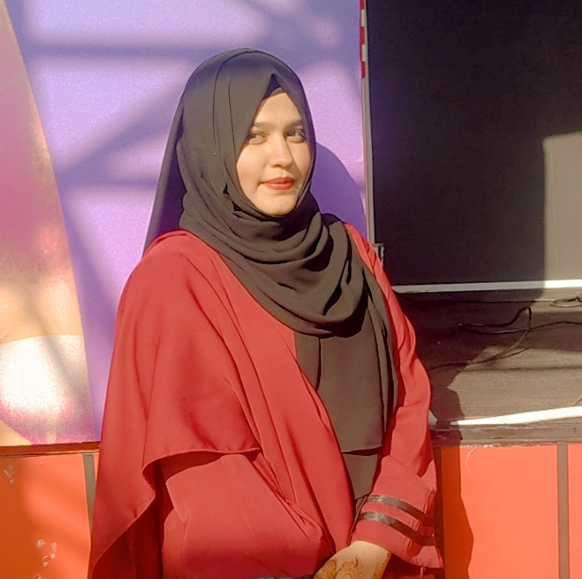

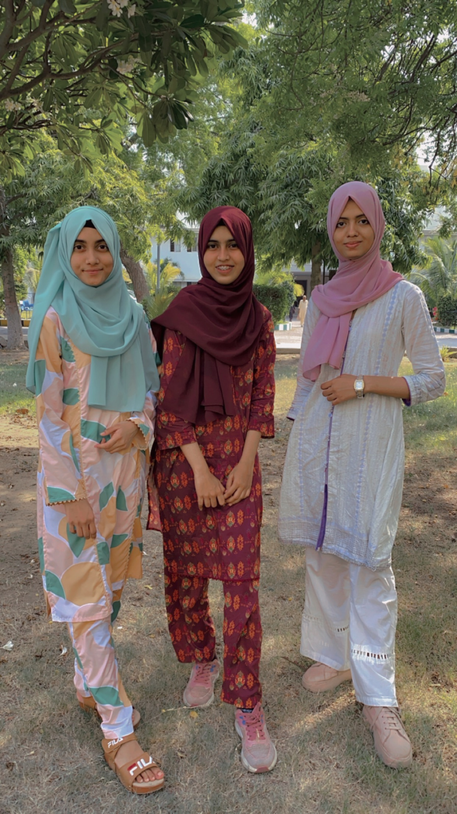

Team Contributor
For Final Year Design Project.
UMMehani hussain
HAYA ZAIN
AREEJ SIDDIQUE
ATROOBA ARIF
EL-21055
EL-21050
EL-21049
EL-21046
1

Slide 3

Contents
Problem Statement………………………………………………………………………………………3
Project Overview ……………..………………………………………………………………………….4
Importance of Multi-Lane]…………………..……………………………………………………….5
Methodology
Software Implementation for Multi-Lane Detection………………………………….6
Hardware Implementation for Multi-Lane Detection………………………………..8
Gantt Chart…………………………………………………………………………………………………..9
Sustainable Development Goals……………………………………………………………….…10
Challenges…………………………………………………………………………………………………..11
Project is Relevant to Field…………………………………………………………………………..12
Benefits……………………………………………………………………………………………………….13
References………………………………………………………………………………………………….14
2

Slide 4

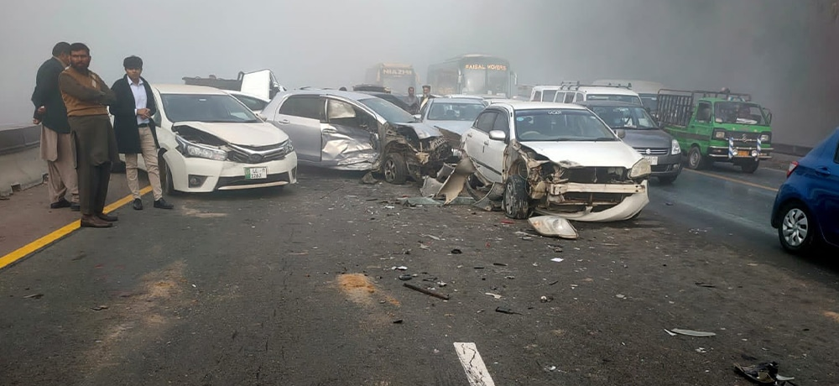
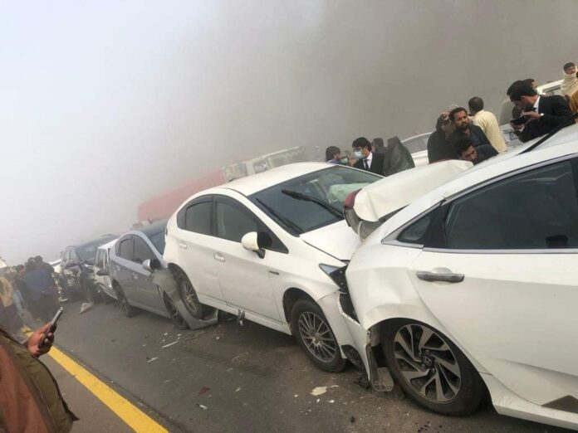
PROBLEM STATEMENT
Road Safety Concerns: With the increasing complexity of urban traffic, accidents have become a major concern.
Statistics: In 2021, According to a World Health Organization (WHO) about 1.3 million people die each year as a result of road incidents. [3]
Fig. 1. Two Die in a Massive Multi-Car Collision on Lahore Motorway, December 22, 2021. [1]
Contributing Factors: Driver errors and variable road conditions, such as weather changes and poor visibility, lane maintenance and overall road safety.
Need for a Solution: The urgent need for enhanced road safety highlights the importance of developing a multi-lane detection system to prevent accidents.
Fig. 2. Accident on M2 Motorway , 30 vehicles collided in Islamabad, 30th November 2021[2]
3

Slide 5
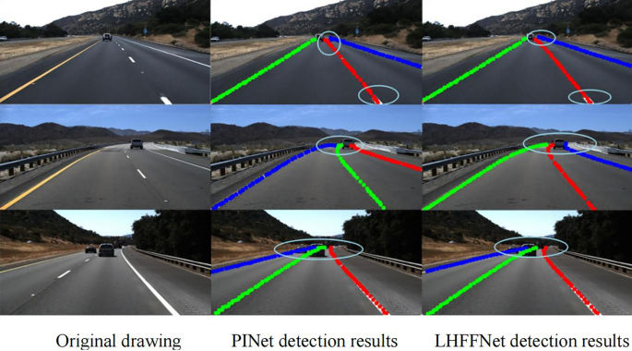
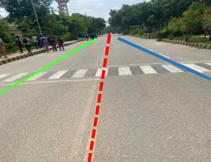
PROJECT OVERVIEW:
The purpose of this project is to develop a system for detecting multiple lanes in autonomous vehicles. Using neural networks, the system will help vehicles identify lanes efficiently, improving their ability to follow traffic rules and ensure safe driving, especially in complex environments.
4
Fig. 3. A Multiple Lane Detection [6]
Fig. 4. Multi-Lane Roadway

Slide 6


`
Why multi-lane is important?
1.
Helps drivers stay in the correct lane.
2.
Improves traffic flow by detecting multiple lanes.
3.
Enhances safety in complex road conditions.

Slide 7
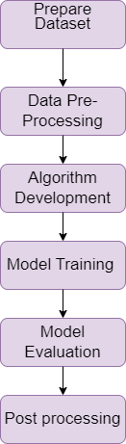
METHODOLOGY:
Software Implementation FOR MULTI-LANE DETECTION:
Prepare Dataset: A dataset should be prepared by combining images with their labels.
Data Pre-Processing: It involves resizing images for uniformity, and adjusting brightness and contrast.[4]
Deep Learning Algorithm: Deep learning algorithm development extracts features from road images using CNN, FCN, and SCNN for lane detection. [5]
Model Training: In model training, the model learns to detect lanes by adjusting parameters, and reducing errors.
Model Evaluation: After training, the model is evaluated. If it meets performance criteria, it’s finalized. If not, it is re-trained.
Post-processing: It enhances results by removing noise, smoothing lane lines, and applying curve fitting.[5]
6
Fig. 5. Software Flowchart

Slide 8
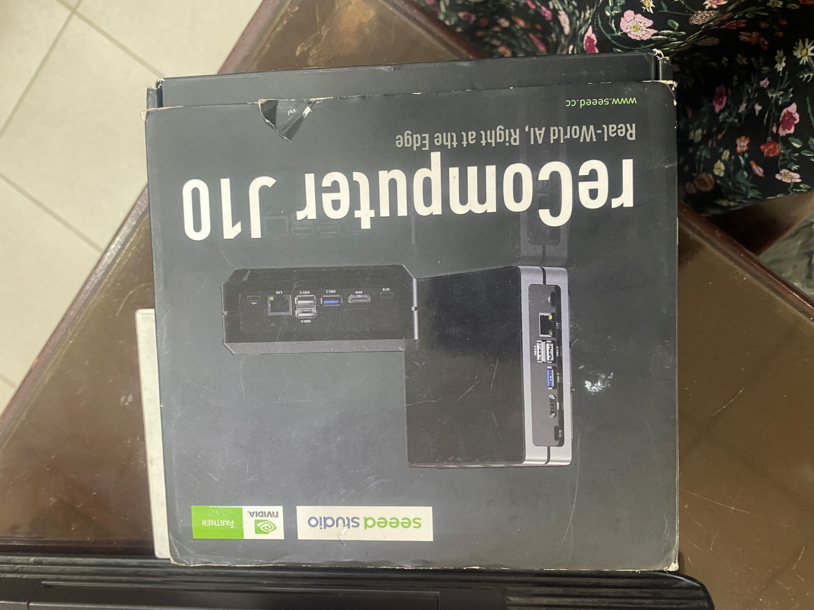
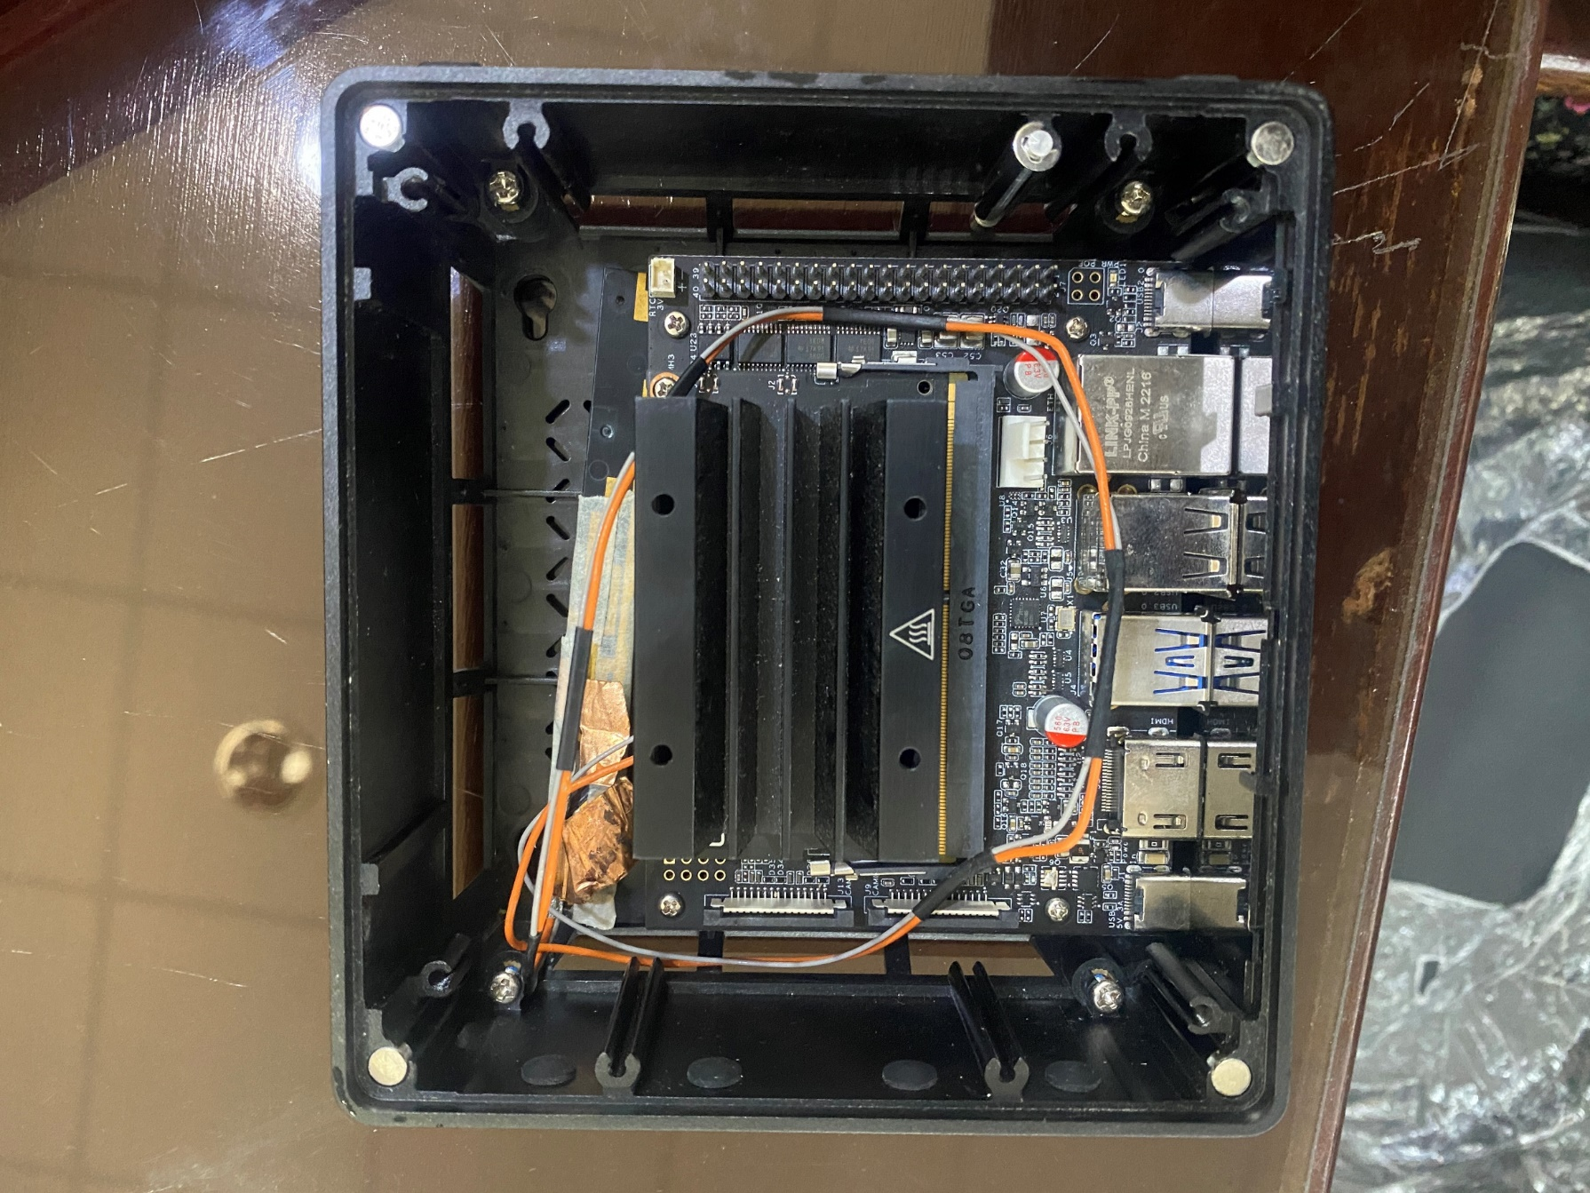
Jetson Nano:
Powerful computer from NVIDIA, designed for edge computing, machine learning, and AI tasks.
Fig. 6. NVIDIA Jetson Nano
Jetson Nano Developer Kit: Ideal for deep learning tasks.
C.P.U: 64-bit quad-core ARM Cortex-A57
RAM: 4GB LPDDR4
STORAGE: 16GB eMMC
POWER SUPPLY: Type-C 5V/3A
Fig. 7. NVIDIA Jetson Nano Developer Kit
7

Slide 9

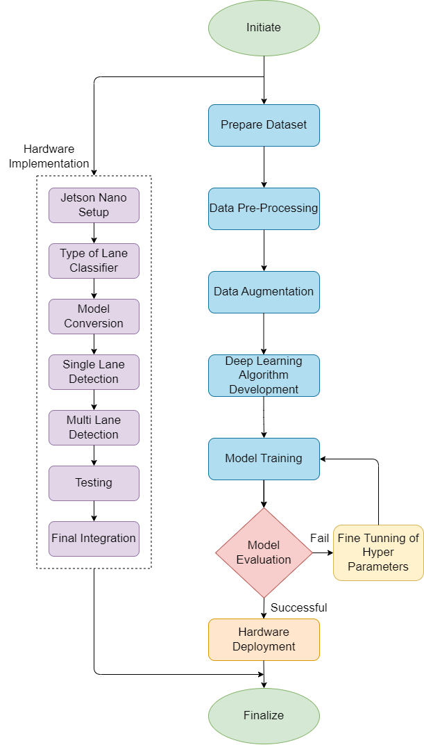
Hardware Implementation for Multi-Lane Detection:
Setup: Configure Jetson Nano for data input and processing. | Single Lane Testing: Verify detection on different road types and conditions.
Lane Classifier: Implement classifier to identify lane types. | Multiple Lane Testing: Ensure detection of multiple lanes in complex scenarios.
Model Conversion: Adapt trained model for Jetson Nano. | Integration & Testing: Load model, adjust software, and test in real-world conditions.
Fig. 8. Hardware Flowchart
8

Slide 10
GANTT CHART
Year | 2024 to 2025
Months | Aug | Sep | Oct | Nov | Dec | Jan | Feb | Mar | April | May | June
Literature Review
Proposal Writing and Project proposal submission
Dataset gathering, searching for software tools, learning python, neural network
Designing algorithm for detection and implementation designing of database and algorithm
Pre-processing of data
Training, Testing, Optimizing Lane Detection Model
Mid-Year Evaluation Preparation
Explore Jetson Nano, Relevant Libraries, and Tools
Single Lane Detection Prototype Implementation and Testing
Multi-Lane Detection Prototype Implementation and Testing
Final integration
Report Drafting and Final Submission
Final evaluation and presentation
9

Slide 11


SUSTAINABLE DEVELOPMENT GOALS
10

Slide 12

CHALLENGES
Complex Labeling
Dataset Quality
Model Selection & Training
Model Complexity
Environmental Variability
Hardware and Software Integration
.
11

Slide 13
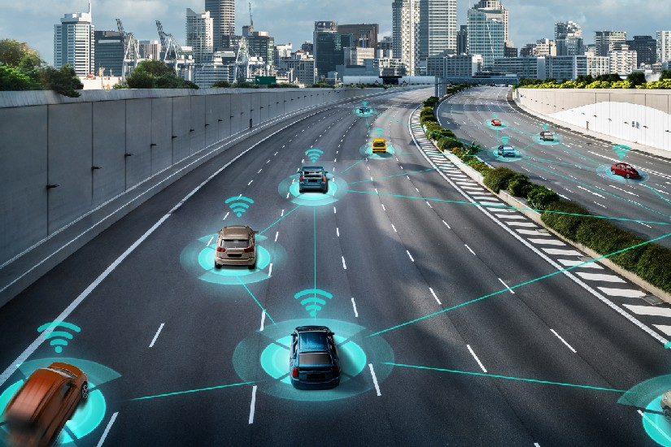

How this project is relevant to our field?
Advanced Hardware Utilization
Real-World Application
Innovation and Industry Impact
System Integration Skills
Skill Development and Future Trends
Fig. 9
12

Slide 14

FuturE Of Multi-Lane
Autonomous driving
Smart City Integration
Enhanced Road Safety
Dynamic Traffic Control
Crucial for enabling fully autonomous vehicles to manage lane changes.
Facilitates real-time traffic communication, reducing congestion.
AI-driven lane detection improves safety by predicting driver behavior.
Enables adaptive lanes for efficient traffic management in the future.
13

Slide 15


[1] Propakistani, "Two die in a massive multi-car collision on Lahore motorway," Dec. 2021. [Online]. Available: https://propakistani.pk/2021/12/22/two-die-in-a-massive-multi-car-collision-on-lahore-motorway/. [Accessed: 11-Sep-2024].
[2] Pakistan Today, "24 hurt as fog causes motorway pile-up," Nov. 2021. [Online]. Available: https://www.pakistantoday.com.pk/2021/11/30/24-hurt-as-fog-causes-motorway-pile-up/. [Accessed: 11-Sep-2024].
[1] World Health Organization, "Global framework for the response to antimicrobial resistance in humans," Sep. 2023. [Online]. Available: https://www.who.int/publications/i/item/9789240086517. [Accessed: 11-Sep-2024].
[4] Q. Wang et al., “Dynamic Data Augmentation Based on Imitating Real Scene for Lane Line Detection,” Remote Sens (Basel), vol. 15, no. 5, p. 1212, Feb. 2023, doi: 10.3390/rs15051212.
[5] F. Chao, S. Yu-Pei, and J. Ya-Jie, “Multi-Lane Detection Based on Deep Convolutional Neural Network,”
[6] IEEE Access, vol. 7, pp. 150833 150841, 2019, doi: 10.1109/ACCESS.2019.2947574.
Kao, Y., Che, S., Zhou, S. et al. LHFFNet: A hybrid feature fusion method for lane detection. Sci Rep 14, 16353 (2024)
14

Slide 16

15

